Slide 1
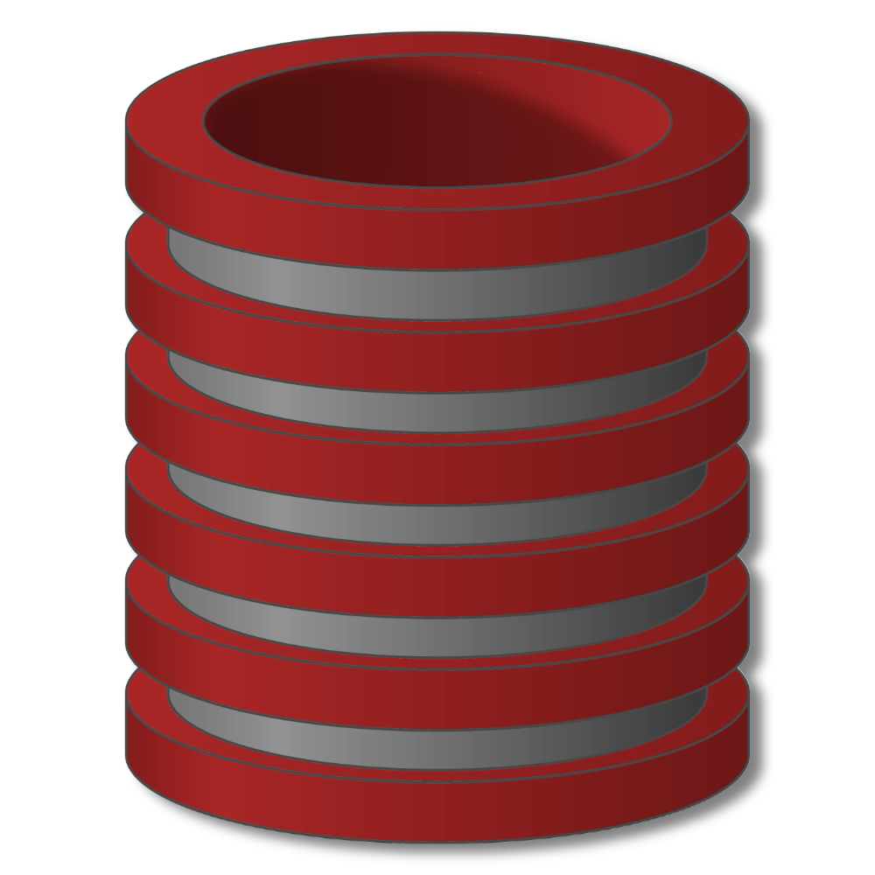
JSON Data
Introduction

Slide 2
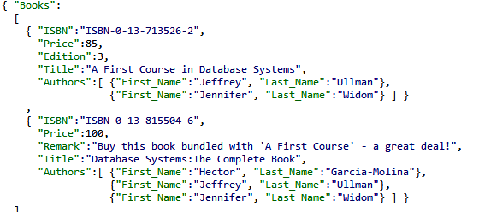
JSON Introduction
JavaScript Object Notation (JSON)
Standard for “serializing” data objects, usually in files
Human-readable, useful for data interchange
Also useful for representing & storing
semistructured data

Slide 3
JSON Introduction
JavaScript Object Notation (JSON)
No longer tied to JavaScript
Parsers for many languages

Slide 4
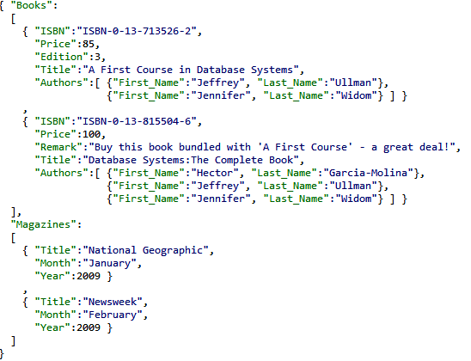
JSON Introduction
Basic constructs
(recursive)
Base values
number, string, boolean, …
Objects { }
sets of label-value pairs
Arrays [ ]
lists of values

Slide 5
JSON Introduction
Relational Model versus JSON
 | Relational | JSON
Structure
Schema
Queries
Ordering
Implementation

Slide 6
JSON Introduction
XML versus JSON
 | XML | JSON
Verbosity
Complexity
Validity
Prog. Interface
Querying

Slide 7
JSON Introduction
Syntactically valid JSON
Adheres to basic structural requirements
Sets of label-value pairs
Arrays of values
Base values from predefined types

Slide 8
JSON Introduction
Syntactically valid JSON
Adheres to basic structural requirements
Sets of label-value pairs
Arrays of values
Base values from predefined types
JSON
File
JSON
Parser
Program
objects
Syntactic errors

Slide 9
JSON Introduction
Semantically valid JSON
Adheres to basic structural requirements
+ conforms to specified schema
JSON
File
JSON
Validator
JSON
Parser
Program
objects
JSON
Schema
Syntactic errors
Semantic errors

Slide 10
JSON Introduction
JavaScript Object Notation (JSON)
Standard for “serializing” data objects in
human-readable format
Useful for data interchange, and for representing
& storing semistructured data

